Slide 1
CECS 450 Data Visualization
Project 1
Members: Ryan Valdriz, Sarita Kumari, Matthew Szeto, Martin Mao, San Yoon

Slide 2
Contributions
Data Processing - Sarita
Using statistical measures (in python) for data filtering and data analysis
Visualization 1 (Heatmap) - Martin
Visualization 2 (Mouse Click Slider) - Martin/San
Programming the slider to do what we wanted
Visualization 3 (Fixation Point Animation) - Matthew/Sarita
Visualization 4 (Convex Hull) - Ryan

Slide 3
Data Processing
Data Parsing - Bringing the data to the desired format(CSV/XLSX) and adding column headers
Data Cleaning- Clearing the noises in the data
Removing rows with dummy/negative values
Data Scaling
Data Mining- Used statistical methods (in python) to discern data patterns
Like count , mean, standard deviation, max and min values of the data
Identify correlation between data that can display valuable information

Slide 4
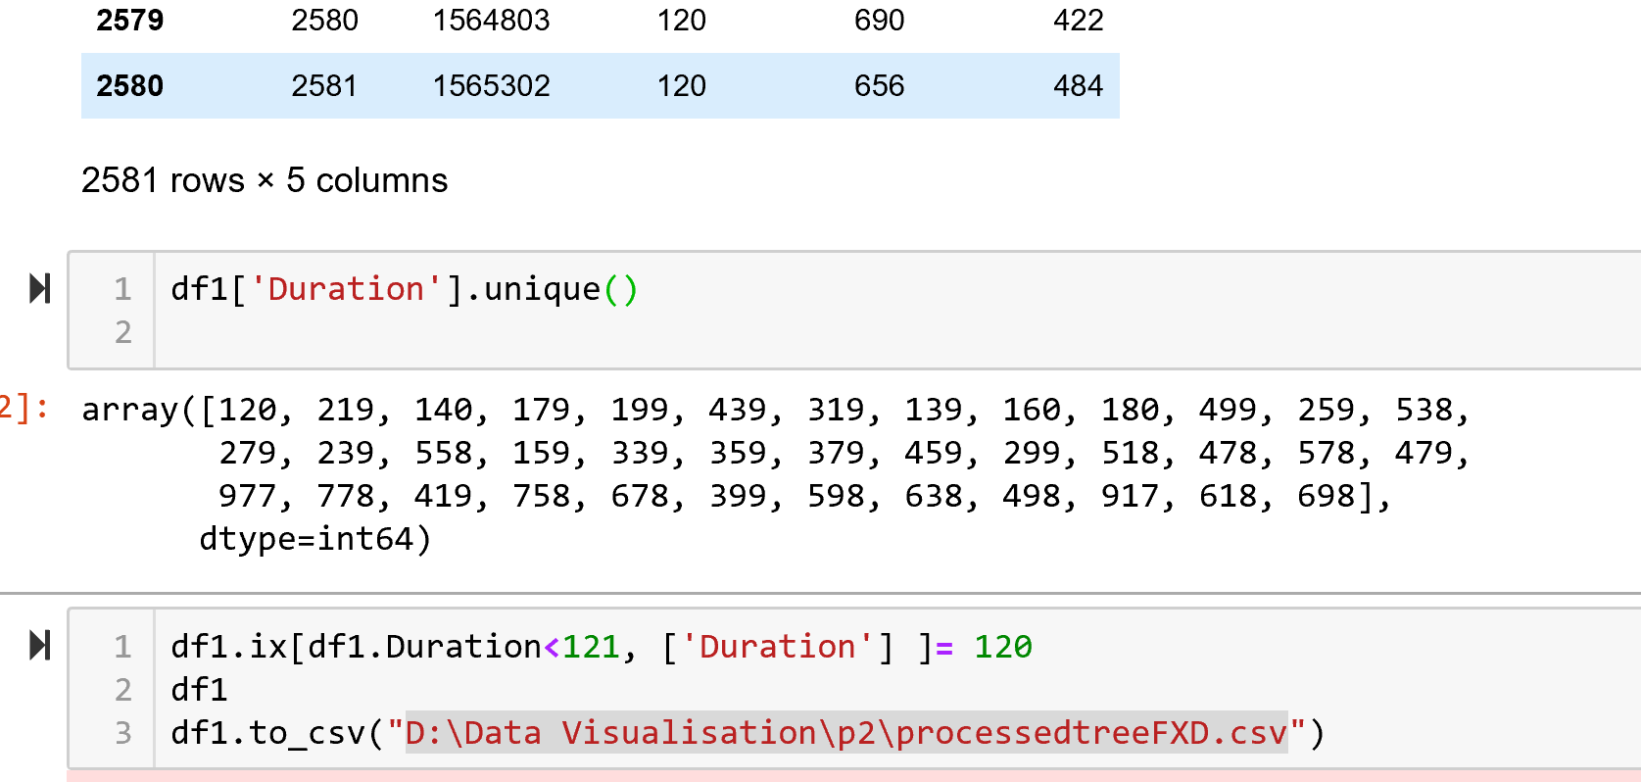
Data Processing code snippet

Slide 5
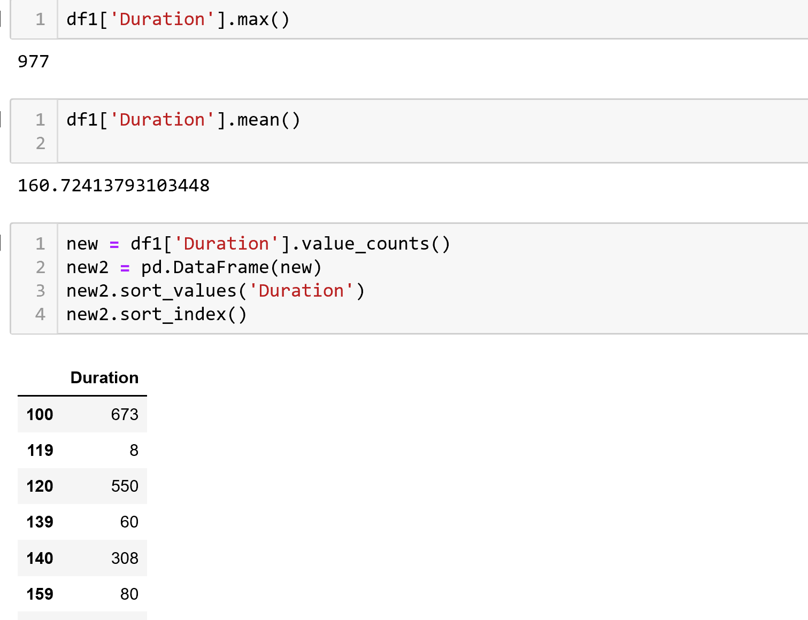
Data Processing code snippet

Slide 6
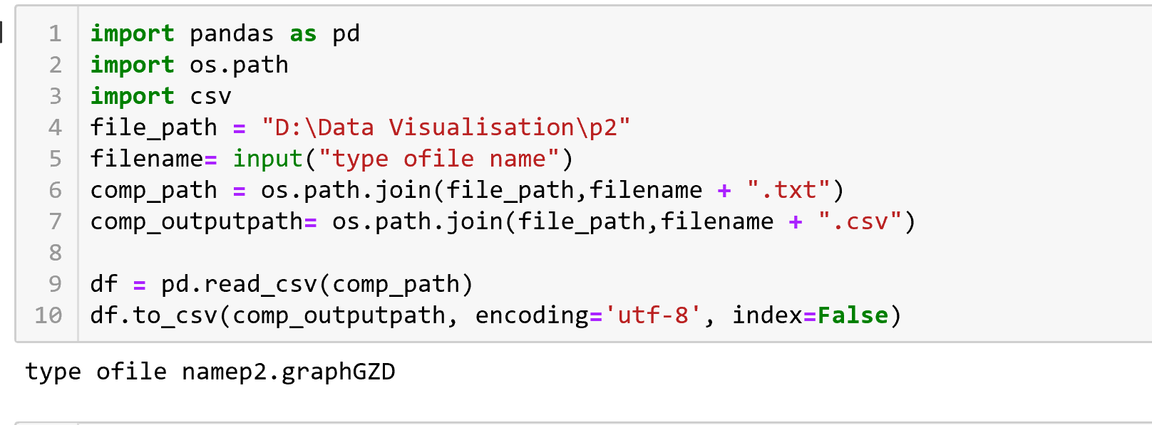
File formatting and conversion to csv

Slide 8
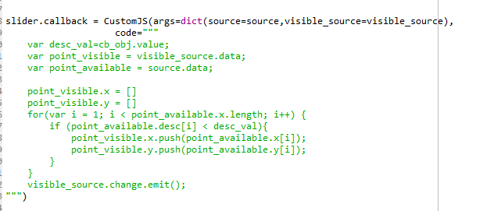
Using json to create slider function

Slide 9
Exploratory Data Analysis
Fixation Dataset(Graph and Tree)
Total valid Observation count after removing data noises
Mean/Avg fixation duration = 120 ms
Max and Min Fixation duration= 971/97 ms
Repeated X and Y coordinates
Distinct fixation duration and its count
Count of distinct Duration gave the number of attempts participant encountered difficulty/ease while visualizing the datasets

Slide 10
Exploratory Data Analysis
Gaze Dataset
Calculating mean Pupil size(left and right eye)
Calculating Pupil size difference of left and right eye
Compared Pupil size from both Tree and Graph Dataset for the participant- Concluded Participant has same pupil size
Validity Code is more reliable based on sitting distance calculation

Slide 11
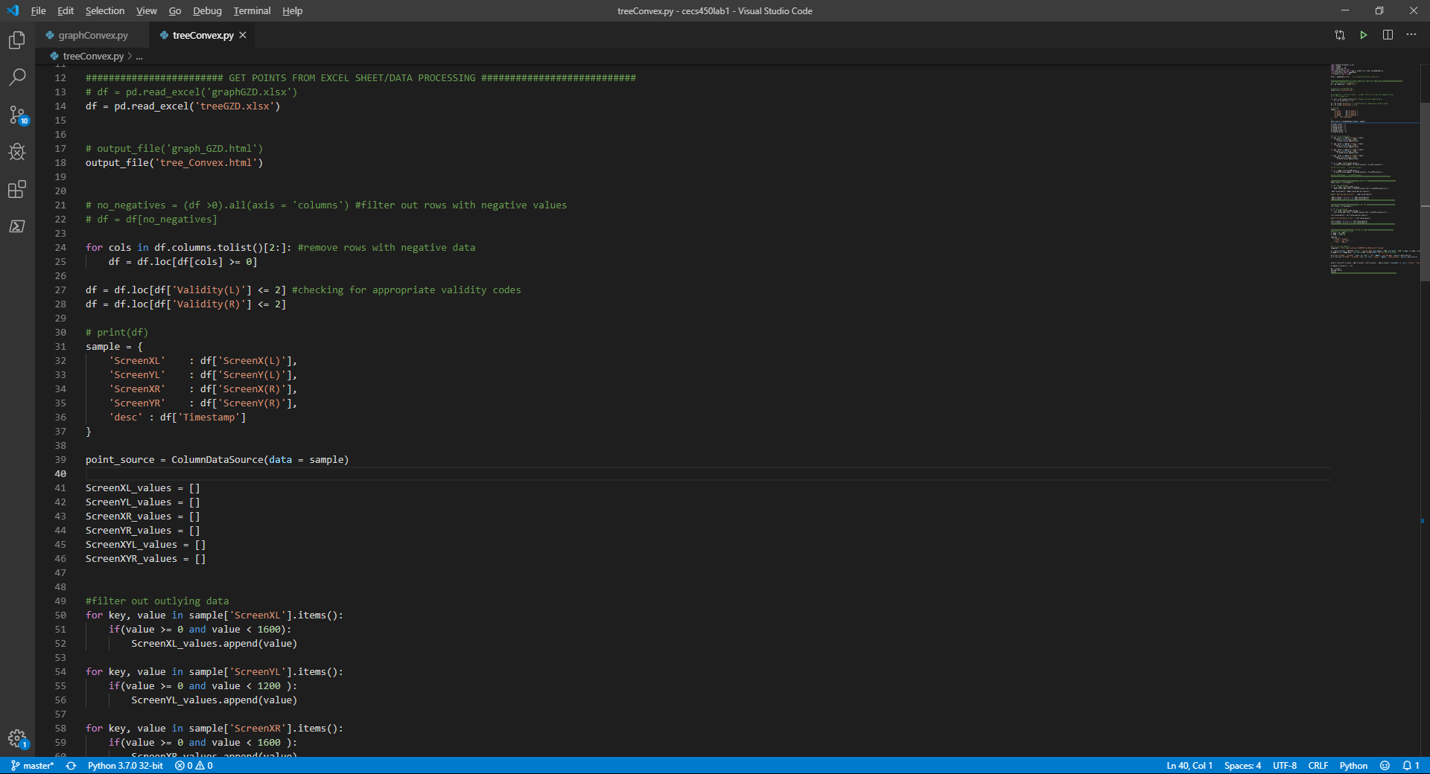

Slide 12
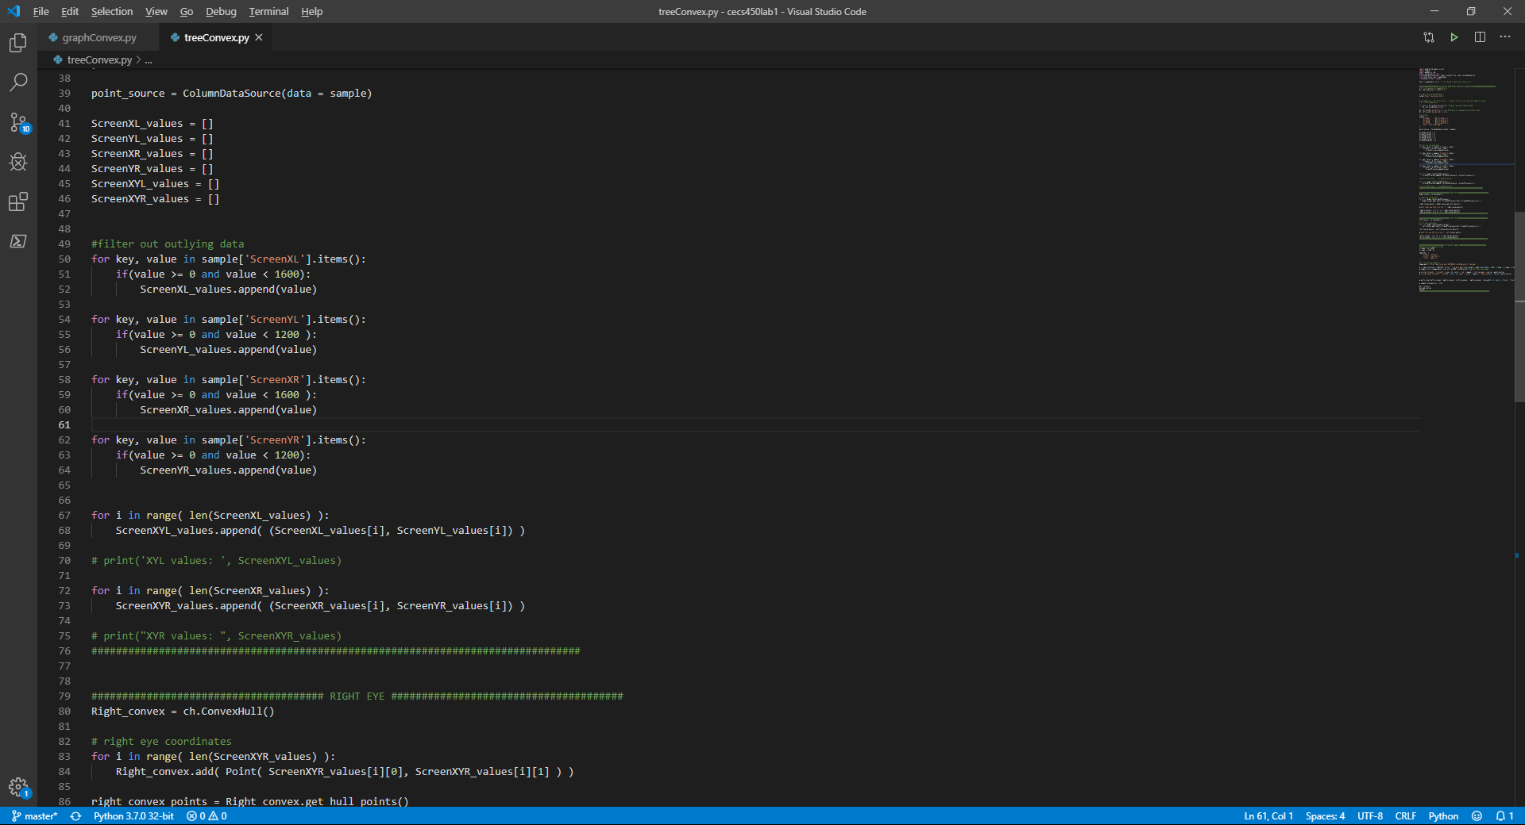

Slide 13
HeatMap

Slide 14
Goal
To see which visualization was more efficient ( Tree vs Graph )
Measures of Search
Measures of Information Processing
Measures of Cognitive Workload
See any patterns in the data?
See the important parts of each visualization?

Slide 15
Design & Implementation
Tree and Graph
Heatmap
Shows the locations of the fixation point as a colored plot point
Darker color represents longer duration of fixation
Lighter color represents shorter duration of fixation
Interaction
Hove over a point for:
(X,Y) coordinates
Duration in ms

Slide 16
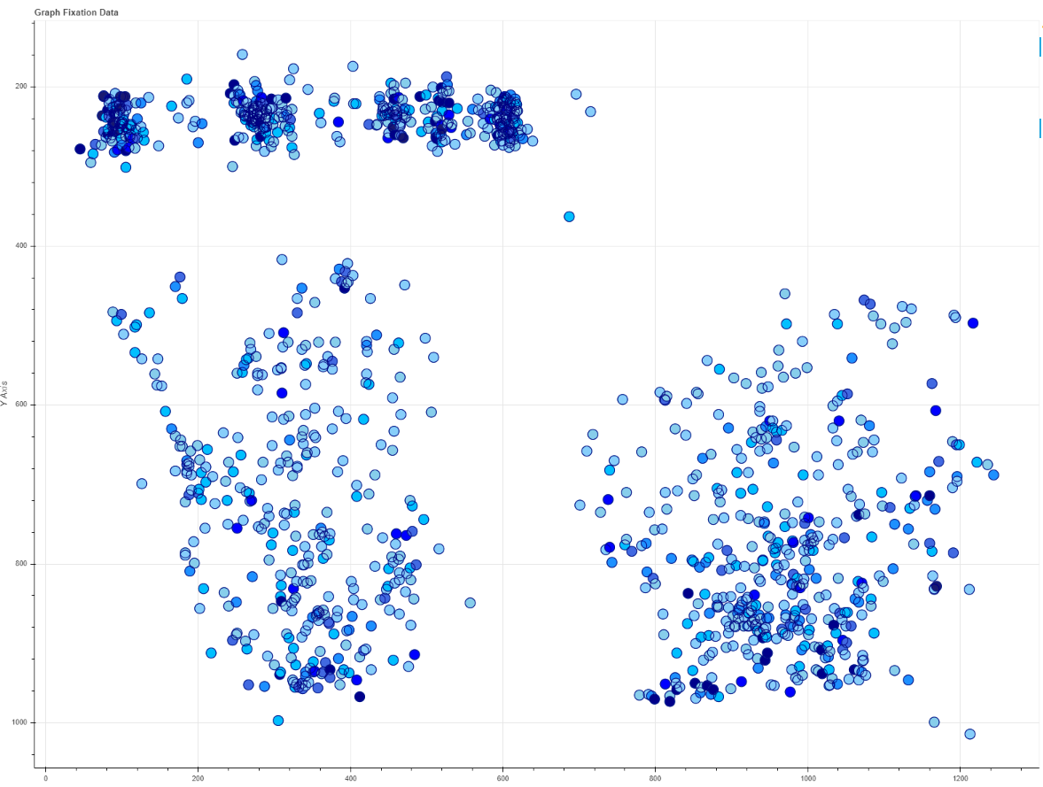
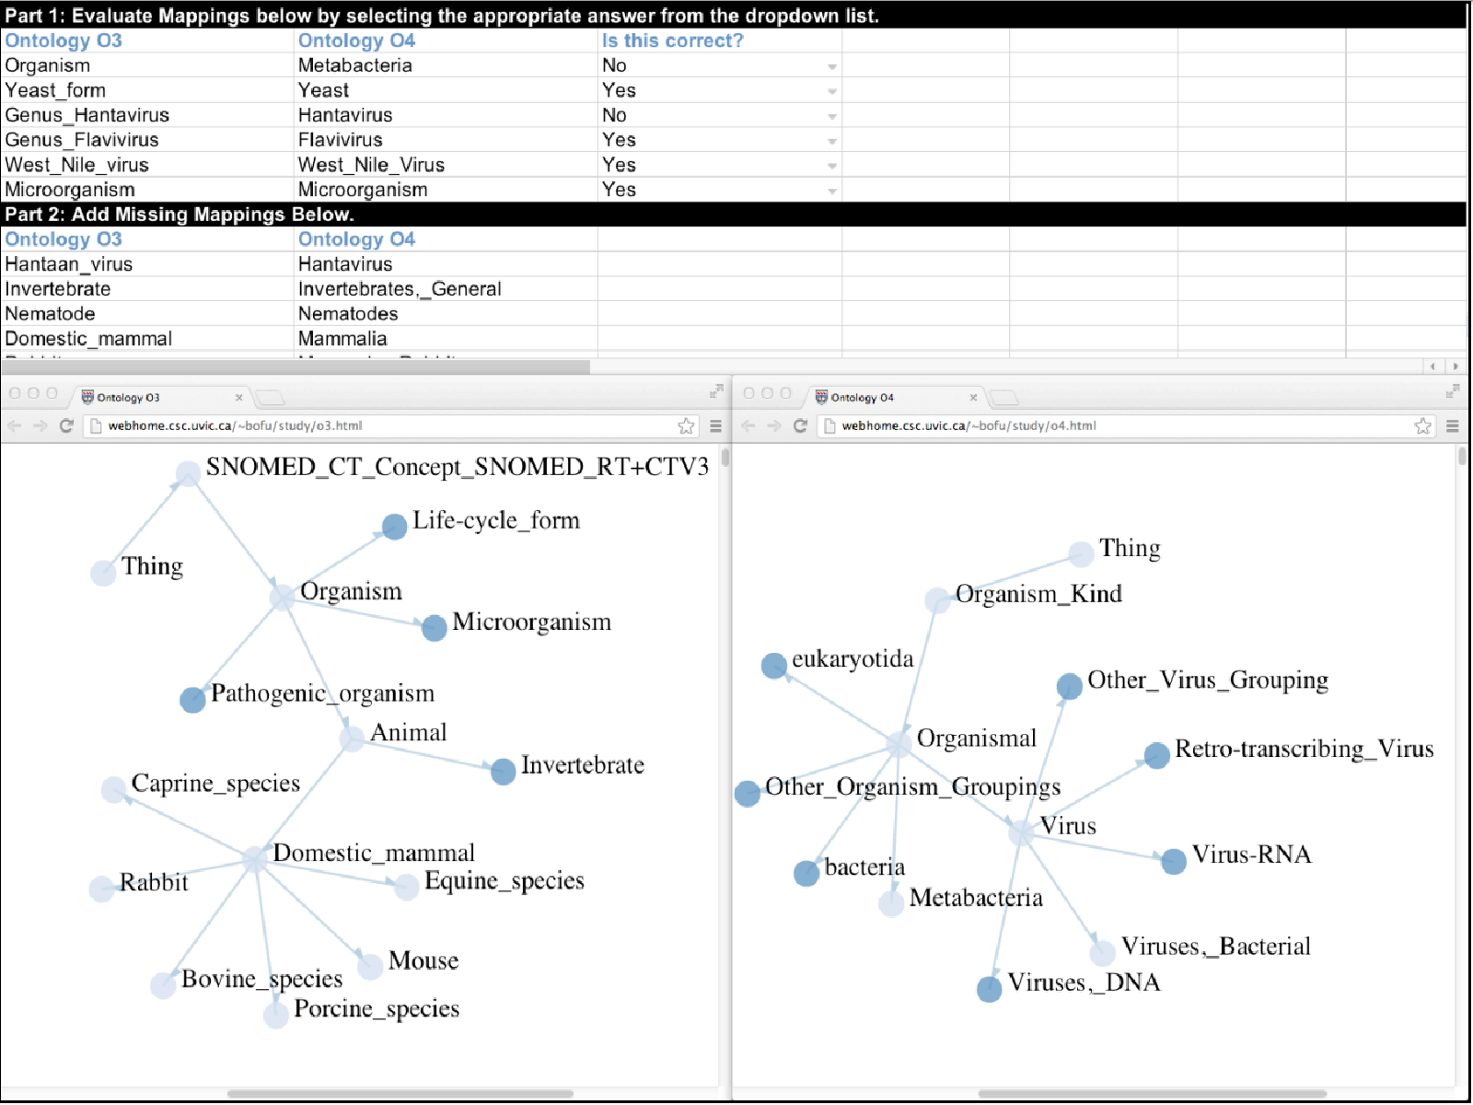
Graph Fixation Date

Slide 17
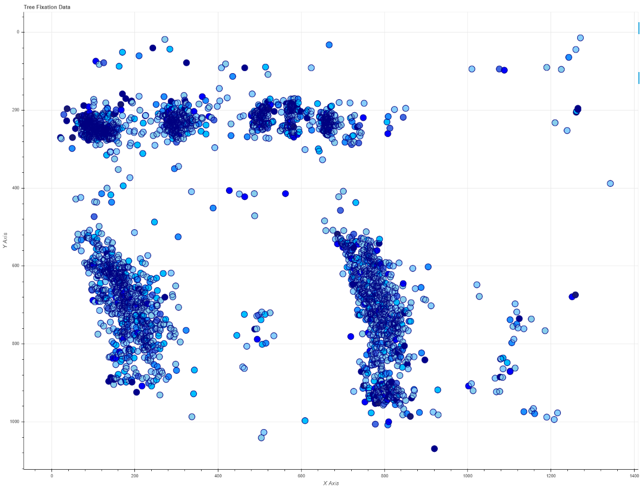
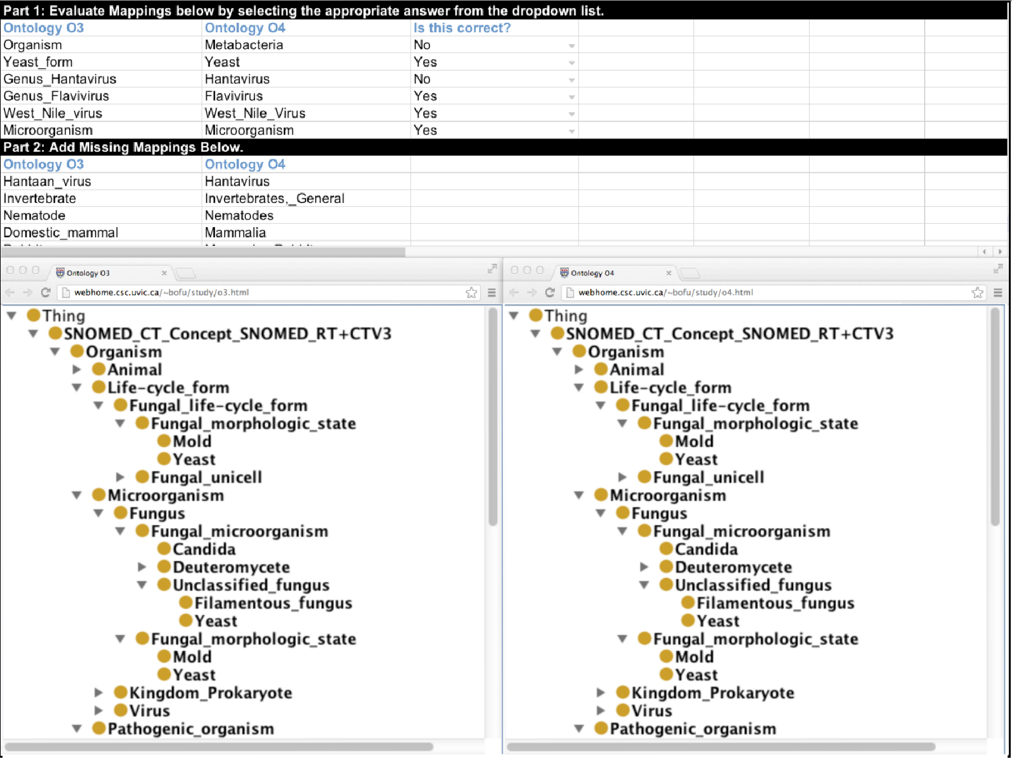
Tree Fixation Date

Slide 18
Mouse Click Slider

Slide 19
Goal
To see which visualization was more efficient ( Tree vs Graph )
Measures of Search
Measures of Information Processing
Measures of Cognitive Workload
See any patterns in the data?
See the important parts of each visualization?

Slide 20
Design & Implementation
Event Data
Goal was to show the location of clicks from the first click to the last click in sequential order
Programmed slider to display x/y coordinates of the event “LMouseButton” relative to their timestamps
Moving the slider forward in time will gradually display all the clicks that the user made on the screen
Interaction
Using slider to adjust the time to show different range of data

Slide 21
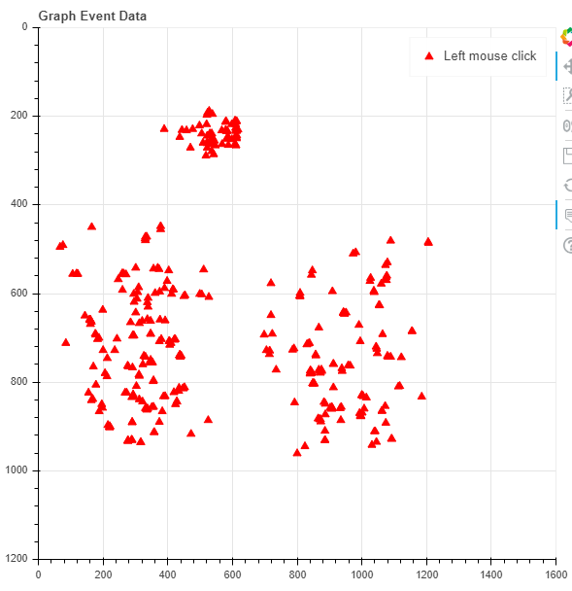
Event Data for Graph

Slide 22
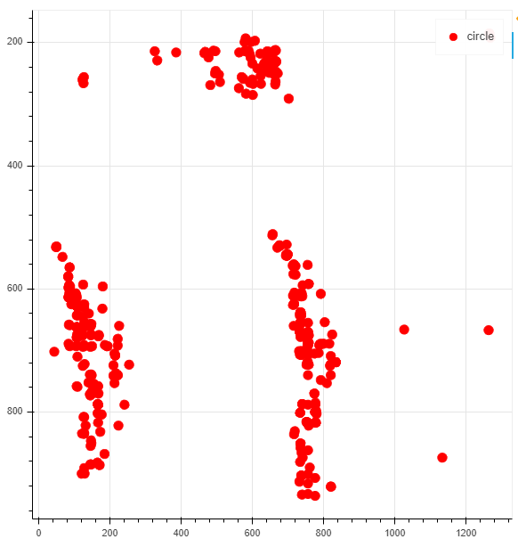
Event Data for Tree

Slide 23
Fixation Point Animation

Slide 24
Goal
To see which visualization was more efficient or difficult ( Tree vs Graph )
Measures of Search
Duration of longer and shorter vision of the participant
Measures of Information Processing
Measures of Mental Workload
Fixation Density
Cognitive track
See any patterns in the data?
See the important parts of each visualization?

Slide 25
Design & Implementation
Graph and Tree
A picture of background graph/tree to give a relatively accurate representation of the screen
Wanted to show the different pattern of visualisation for analysing a graph and a tree by the participant
Path of participants eye Gaze for tree and graph visualization
Distance between each point(coordinates) using lines
Further the distance of information = less optimal visualization
More longer fixation duration- more complex analysis by the participant
Lesser fixation duration -ease of analysing that area by the participant
Created a animation of every fixation point relative to time
Follows the user’s eye throughout
Size of the circles determine the amount of time fixated at one point

Slide 26
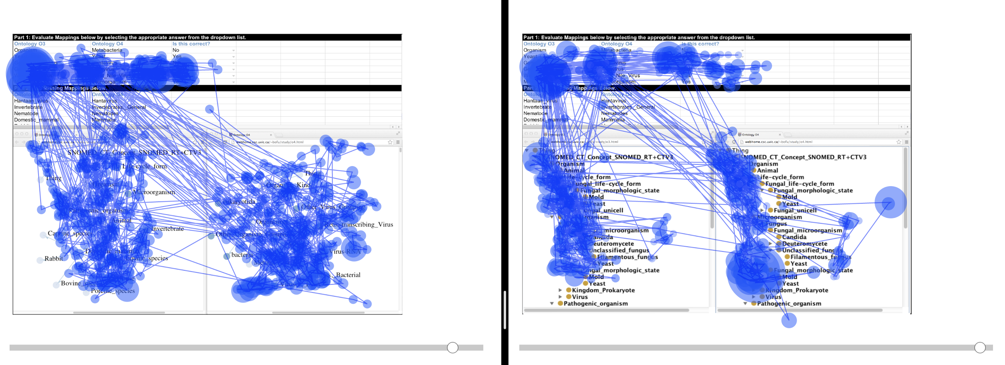

Slide 27
Convex Hull

Slide 28
Goal
To see which visualization has a smaller search area ( Tree vs Graph )
Search area can also be seen as the convex hull of all the points
The Convex Hull is the line that completely encloses a set of points in a plane so that there are no concavities in the line
In our case, the convex hull will encase all gaze points on the screen
This means that the area within the convex hull is the search area of the participant
“ It is likely for a well-designed visualization to have a smaller search area coupled with a shorter scanpath. In contrast, a wildly distributed search pattern in poorly designed visualizations is likely to lead to a larger search area with longer scanpath ”

Slide 29
Design & Implementation
Parameters/coordinates
Used Gazepoint X/Y for the coordinates
Interaction
Can click on the legend to remove/add glyphs on the plot
Hove over a point for:
(X,Y) coordinates
Index
Time in ms
Allows you to compare the convex hull of a tree vs a graph

Slide 30
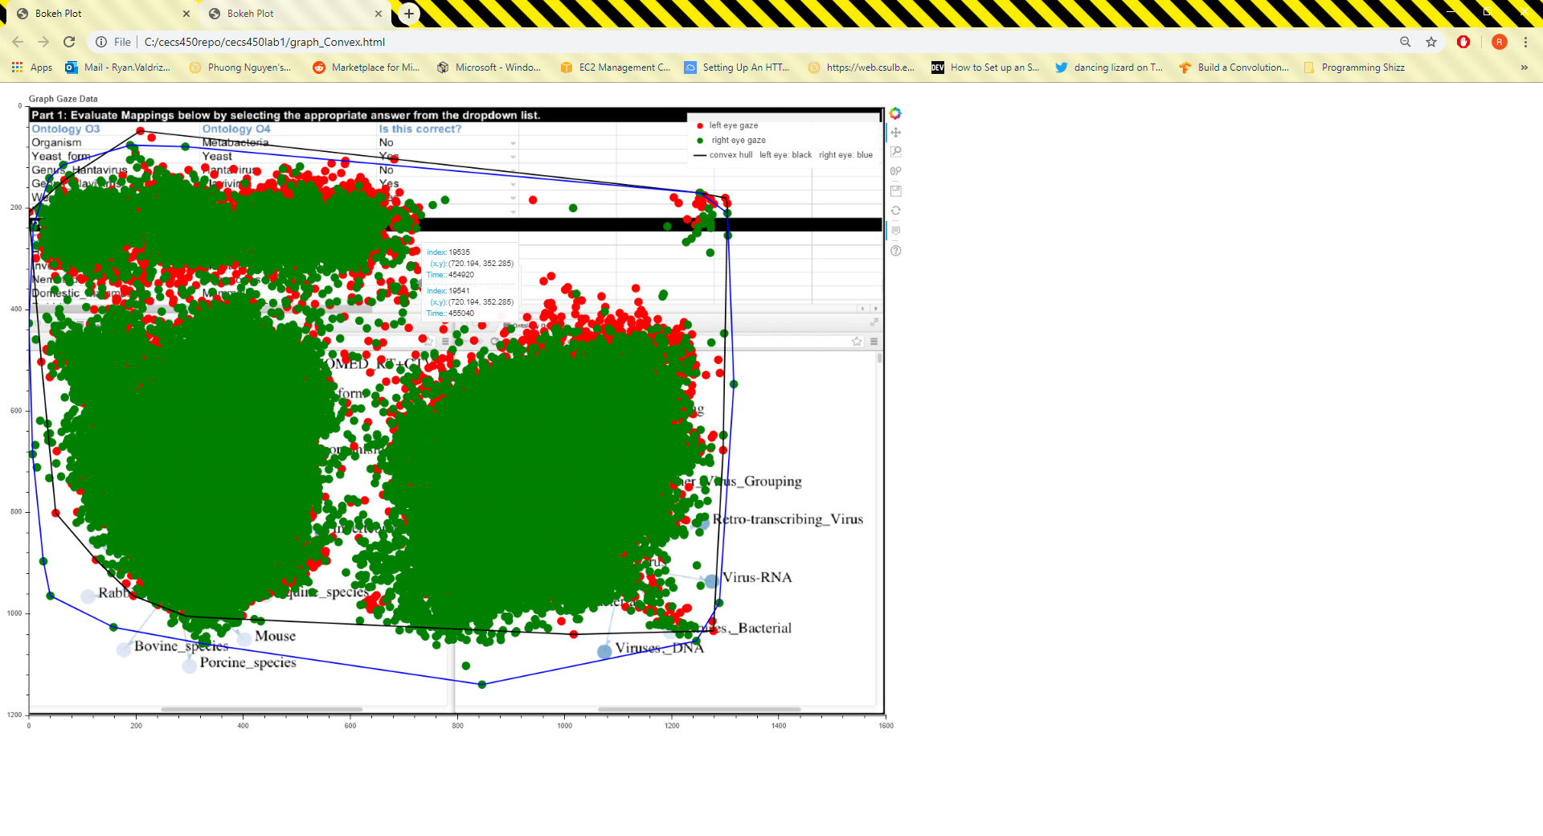
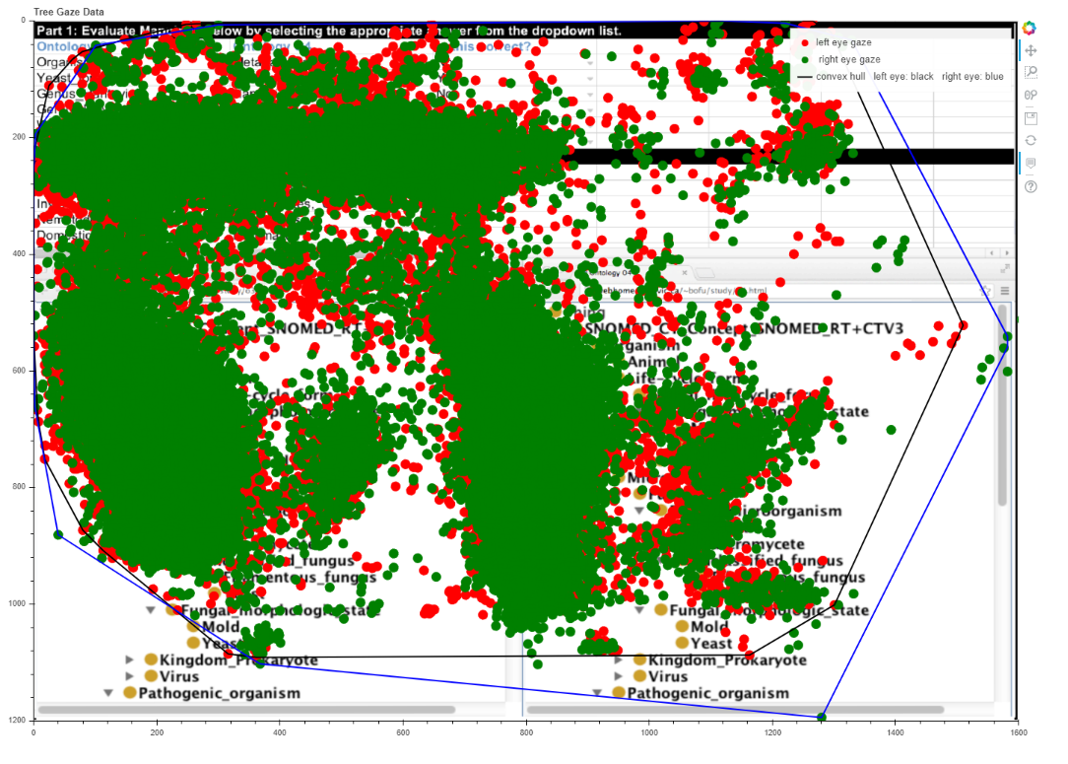
Graph(Left) vs Tree(Right)

